Slide 1


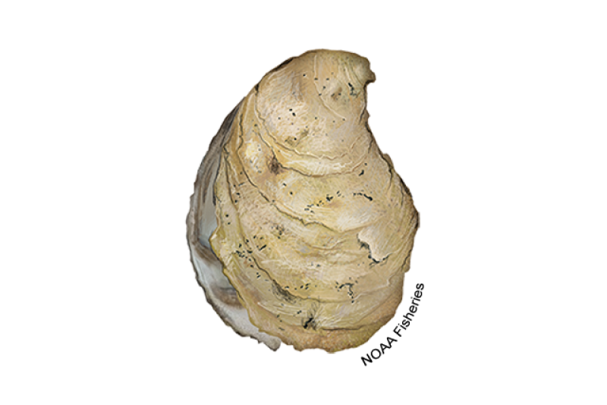
Do farm oysters contribute to ecosystem services? Assessing interbreeding between aquaculture strains and native stocks
Yuqing Chen and Matthew P. Hare
Department of Natural Resources and the Environment, Cornell University
NACE/MAS Oyster Genomics Workshop, Jan. 10th 2024

Slide 2
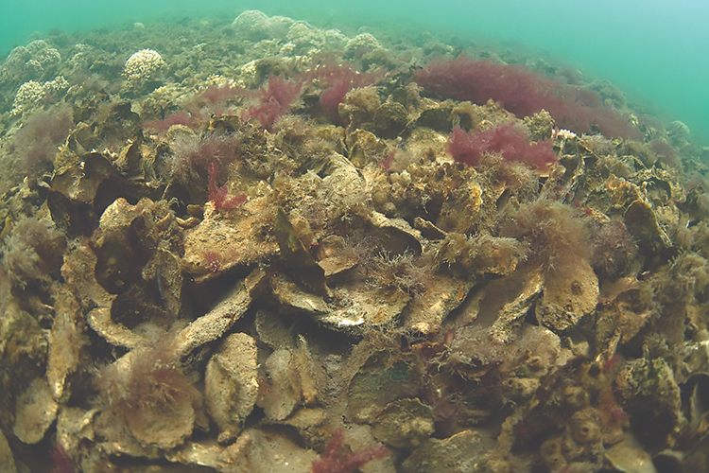
Ecosystem Services Provided by Oysters
Water filtration
Habitat for other species
Recruitment supply for reef network
…
Photo by Oyster Recovery Partnership, retrieved https://www.fisheries.noaa.gov/national/habitat-conservation/oyster-reef-habitat

Slide 3
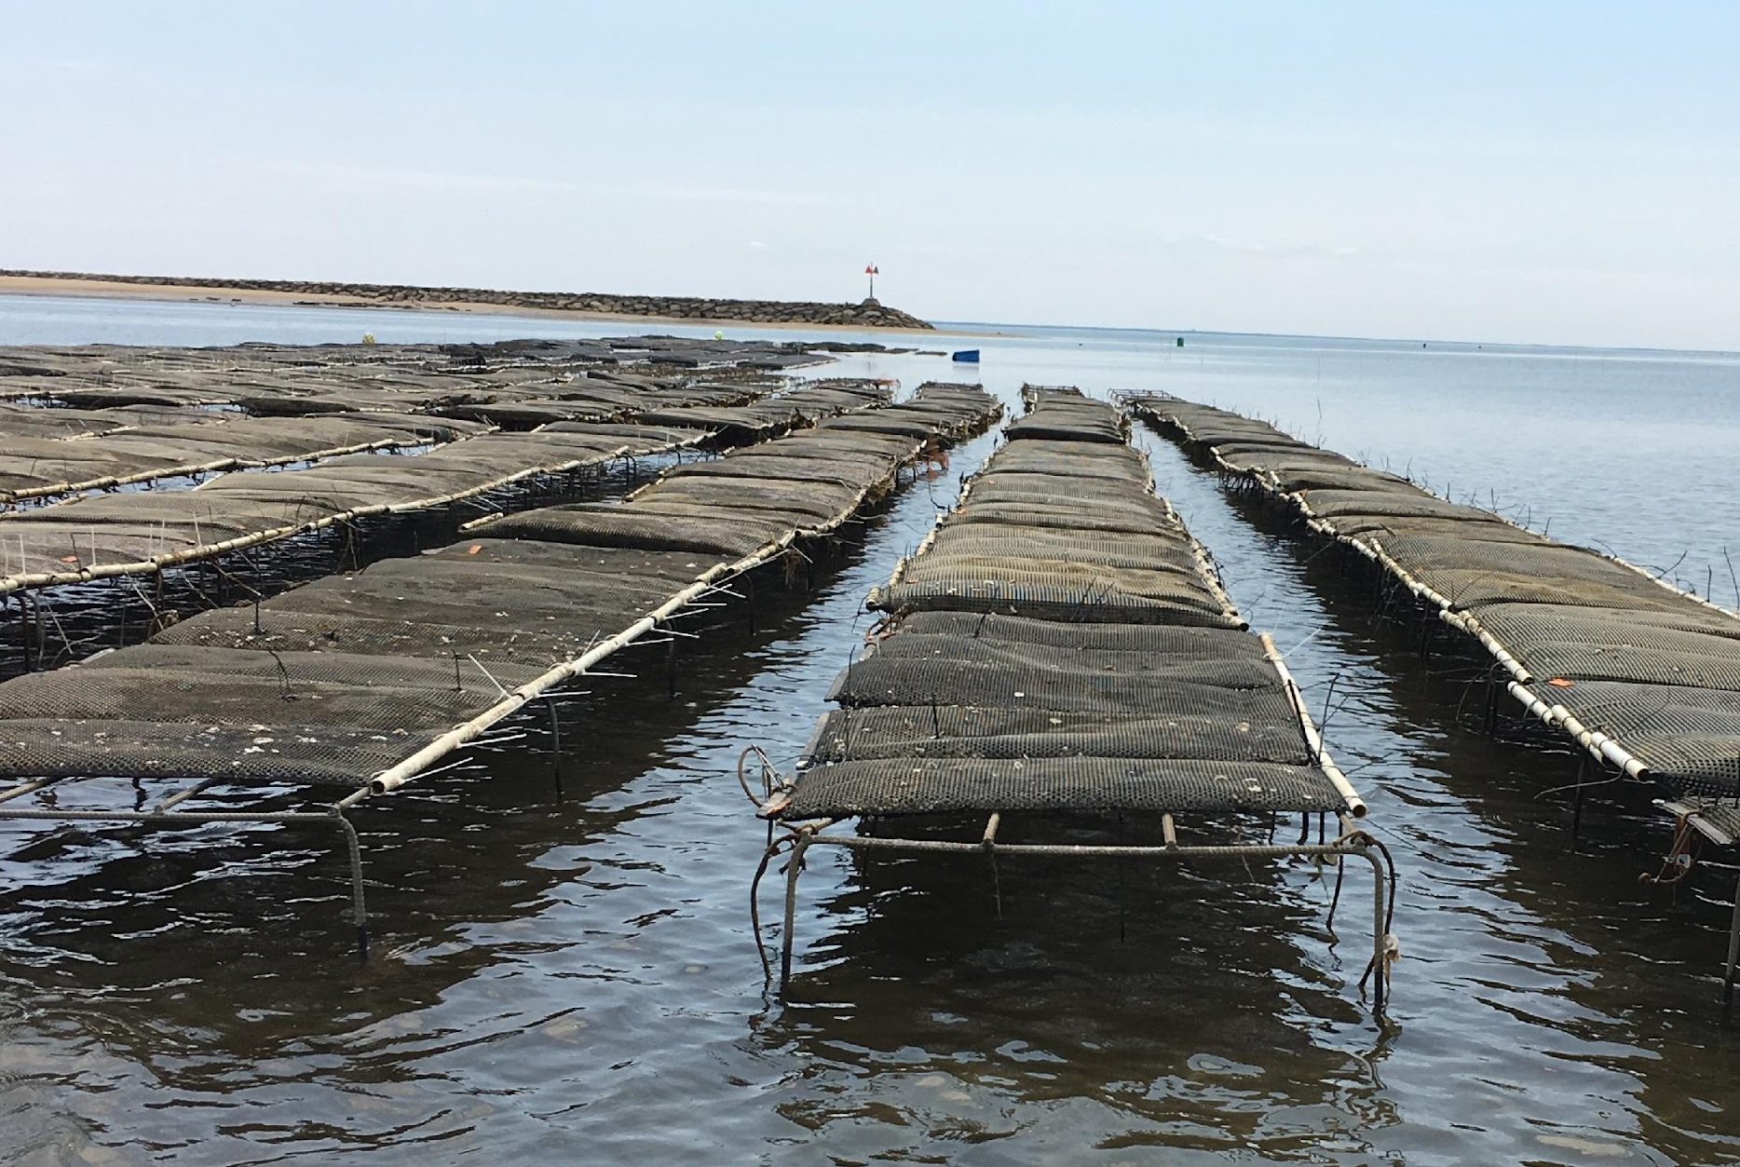
Oyster Aquaculture
Relieve fishing pressure
Address food insecurity
Support local communities
Possibly generate recruitment
Photo by Woods Hole Sea Grant Newsletter

Slide 4
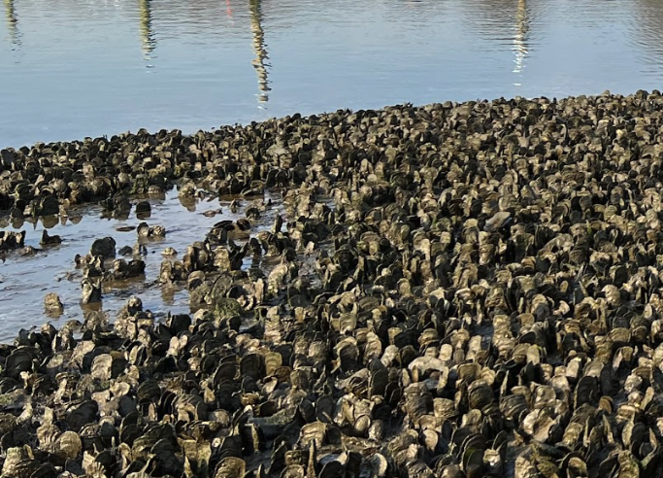
Do aquaculture farm oysters provide ecosystem services by recruiting and interbreeding with native stocks?
Recruitment from farms
Aquaculture Eastern Oysters
Native Eastern Oysters
A mixed population
Larval Dispersal
Interbreeding
Photos by Woods Hole Sea Grant Newsletter (left); Yuqing Chen (right)

Slide 5
Do aquaculture farm oysters provide ecosystem services by recruiting and interbreeding with native stocks?
How can we distinguish between aquaculture and native spat?
How can we measure the extent of aquaculture recruitment in the wild?
Recruitment from farms
Aquaculture Eastern Oysters
Native Eastern Oysters
A mixed population
Larval Dispersal
Interbreeding
Photos by Woods Hole Sea Grant Newsletter (left); Yuqing Chen (right)

Slide 6
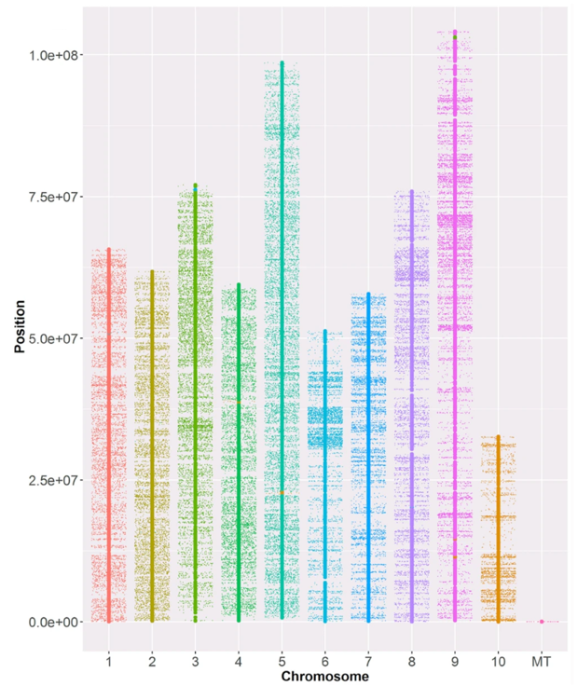
Genomic variations captured by SNP (single nucleotide polymorphism) markers
Chromosomal distribution of SNPs on the Eastern oyster 66K SNP array (Guo et al., 2023)
How can we distinguish between aquaculture and native spat?
Allele frequency differentiation

Slide 7
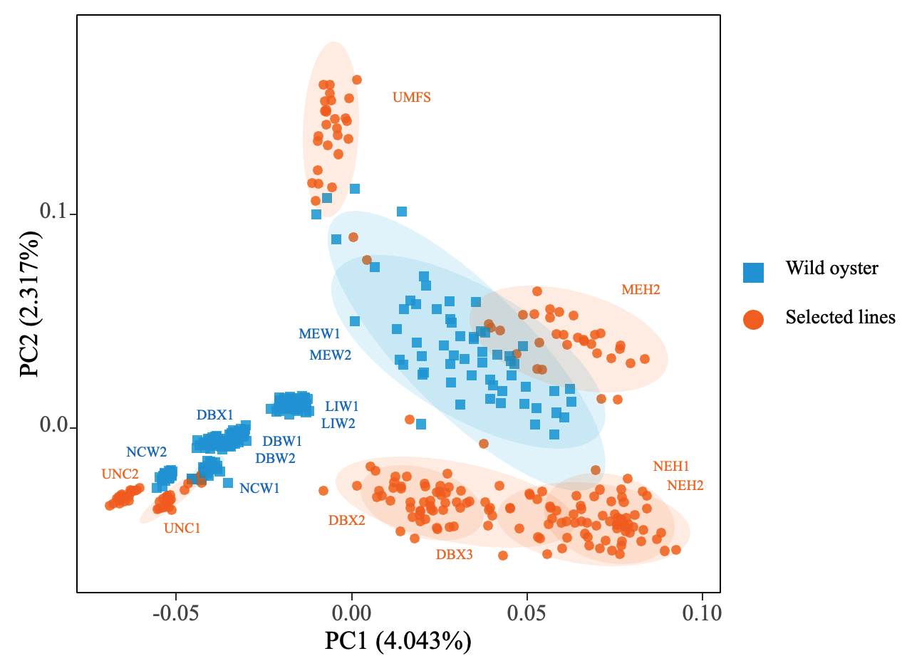
Genomic variations captured by SNP (single nucleotide polymorphism) markers
Chromosomal distribution of SNPs on the Eastern oyster 66K SNP array (Guo et al., 2023)
How can we distinguish between aquaculture and native spat?
Allele frequency differentiation
(Zhao et al.)

Slide 8
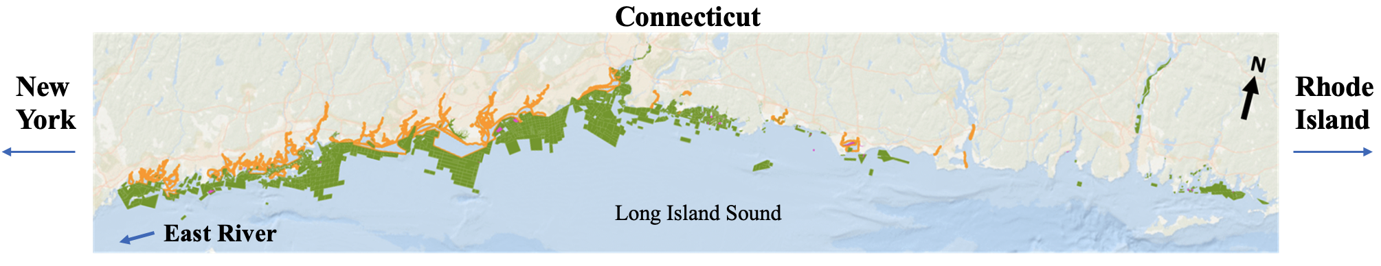
Coastal Connecticut as a case study
Green = Potential aquaculture lease sites Orange = Native oyster beds
From CT Department of Agriculture/Bureau of Agriculture and CT Department of Environmental Protection “Aquaculture Mapping Atlas”.

Slide 9
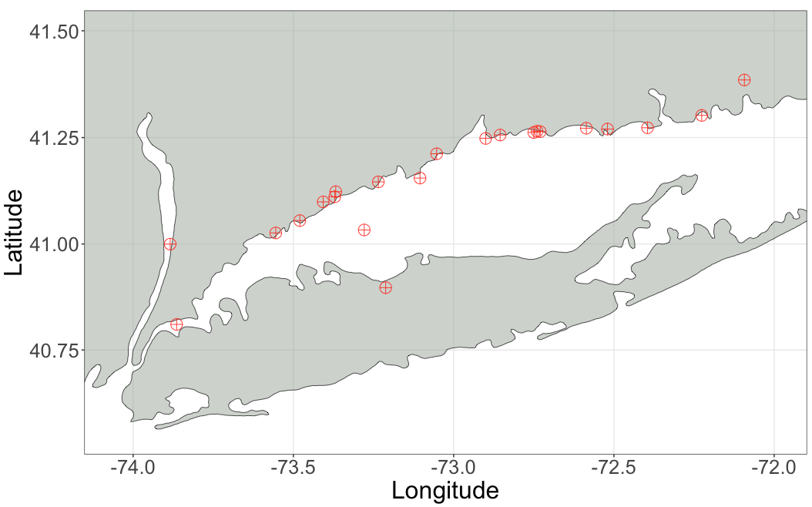
Spat Collection - snapshot of a single annual cohort
Native spat collected from
21 sites in Long Island Sound
Hudson River (wild ref. )
Samples from 6 commonly used aquaculture strains
Connecticut
Hudson River
Long Island Sound
East River

Slide 10
Genomics Analyses
66K Eastern Oyster SNP Array
Axiom Analysis Suite 5.0
Genotyping
Basic Quality Control
SNP filtering
Minor allele frequency 0.05
Genotype call rate > 95%
Individual Missing data < 10%
HWE by population
Biallelic SNPs only
65,862 SNPs
1,278 Individuals
52,885 SNPs
LD pruning
Exclude known inversions
Relatedness filtering
Guo et al. (2022)
42,217 SNPs
1,278 Individuals

Slide 11
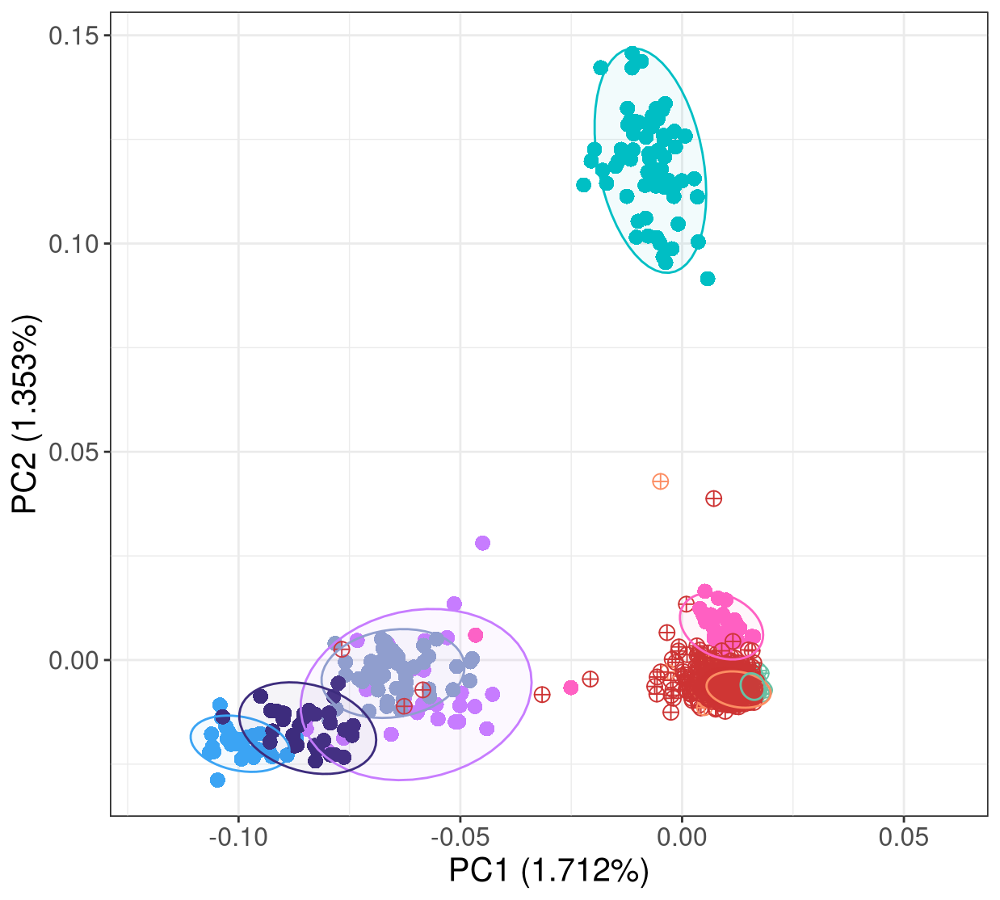
Allele Frequency Differentiation - Principal Component Analysis (PCA)
AQ_3
AQ_1
AQ_4
AQ_2
AQ_6
Hudson River Wild
AQ_5
CT Wild
East River Wild
42.2K pruned SNPs, 1,278 individuals
AQ = aquaculture strains

Slide 12
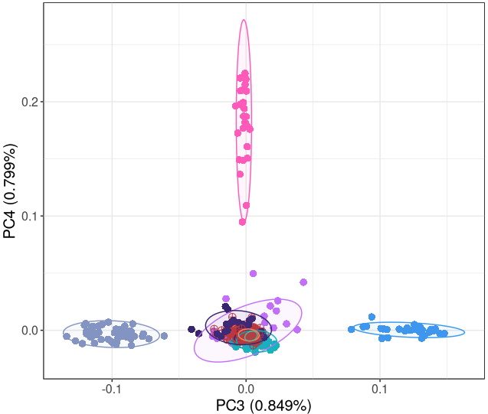
Allele Frequency Differentiation - Principal Component Analysis (PCA)
AQ_3
AQ_4
AQ_1
AQ_4
AQ_2
AQ_6
Hudson River Wild
AQ_1
AQ_5
AQ_5
CT Wild
East River Wild
42.2K pruned SNPs, 1,278 individuals
AQ = aquaculture strains
Notes:
The level of admixture complexity

Slide 13
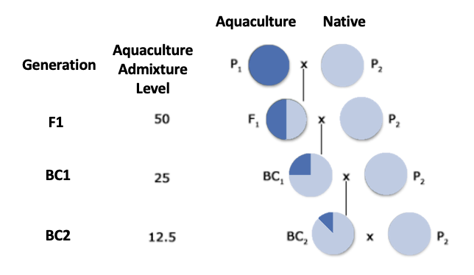
Expected admixture levels
How can we measure the extent of aquaculture recruitment in the wild?
Interbreeding
Admixture

Slide 14
Expected admixture patterns – STRUCTURE analysis
assign genomes to source populations
Aquaculture
Backcross 2 (BC1 x Native)
Backcross 1
(F1 x Native)
F1 Hybrid
Native
Hybrids simulated with HybridLab

Slide 15
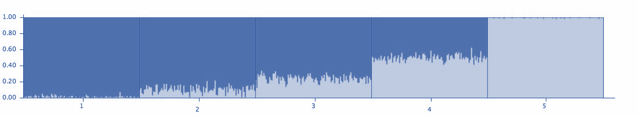
Expected admixture patterns – STRUCTURE analysis
assign genomes to source populations
Aquaculture
Backcross 2 (BC1 x Native)
Backcross 1
(F1 x Native)
F1 Hybrid
Native
Light Blue = Simulated from Hudson River native population
Dark Blue = Simulated from an aquaculture strain
Hybrids simulated with HybridLab

Slide 16
Admixture Analyses - STRUCTURE Results
Please email Yuqing and Matt directly at yc2644@cornell.edu and mph75@cornell.edu to request information about the STRUCTURE results.

Slide 17
Conclusions
Genomic evidence of farm-derived recruitment found in regions across Connecticut coast
Most observed admixture is consistent with backcrossed products, indicating previous interbreeding

Slide 18

Acknowledgements
Thank you!
Cornell Atkinson Sustainable Biodiversity Fund
Cornell Andrew W. Mellon Student Research Grant
Dina Proestou, Angel Carrasquillo, Keegan Hart
Katie McFarland
Tessa Getchis
Milford Laboratory, NOAA Fisheries
Hare Lab:
Harmony Borchardt-Wier
Honggang Zhao
Henry Hua
Email: yc2644@cornell.edu

